Slide 1
Intro to Neural Nets
Course Logistics and Introduction

Slide 2
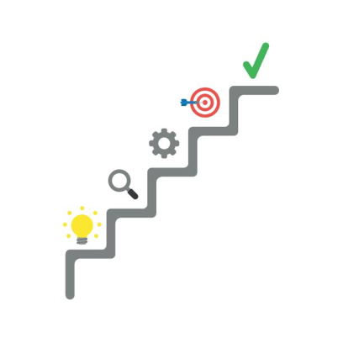
Today’s Agenda
1. COURSE LOGISTICS
Website, schedule, grading and evaluation criteria.
Course textbook, lecture format, etc.
2. INTERESTING USE CASES
Frivolous, academic, and practically useful.
A recent failure, and societal concerns.
3. QUICK INTRODUCTION
What is a neural network?
How does it work?

Slide 3










About Me

Slide 4
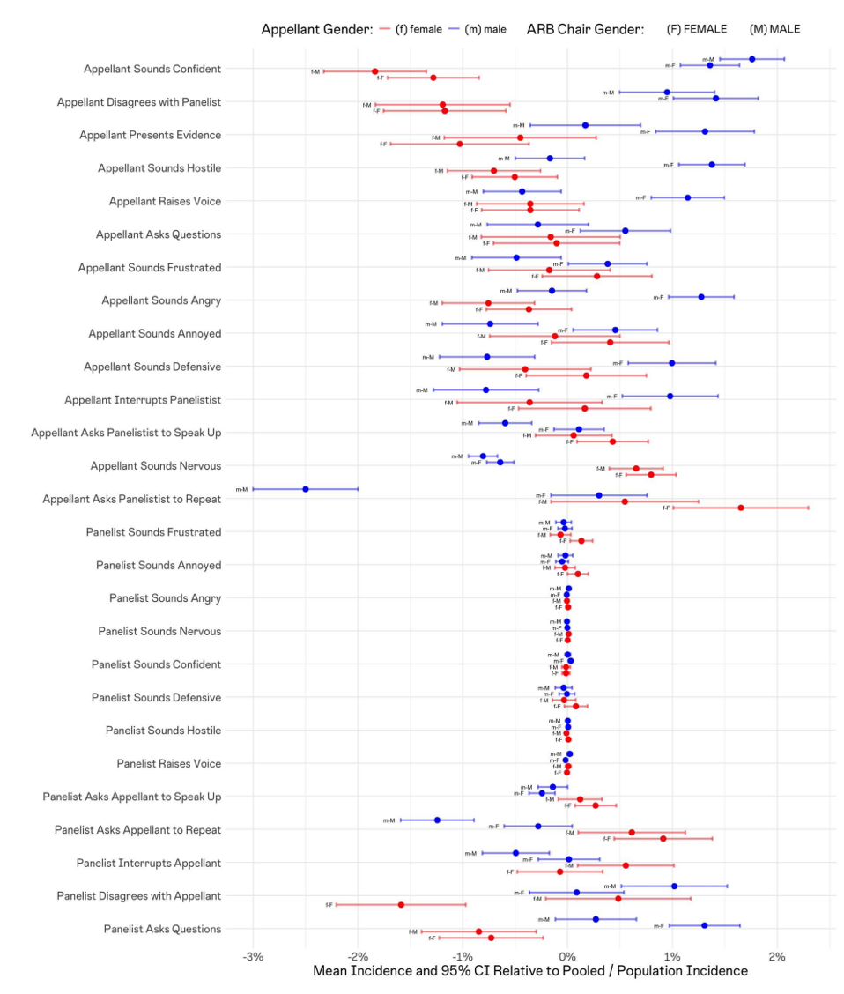
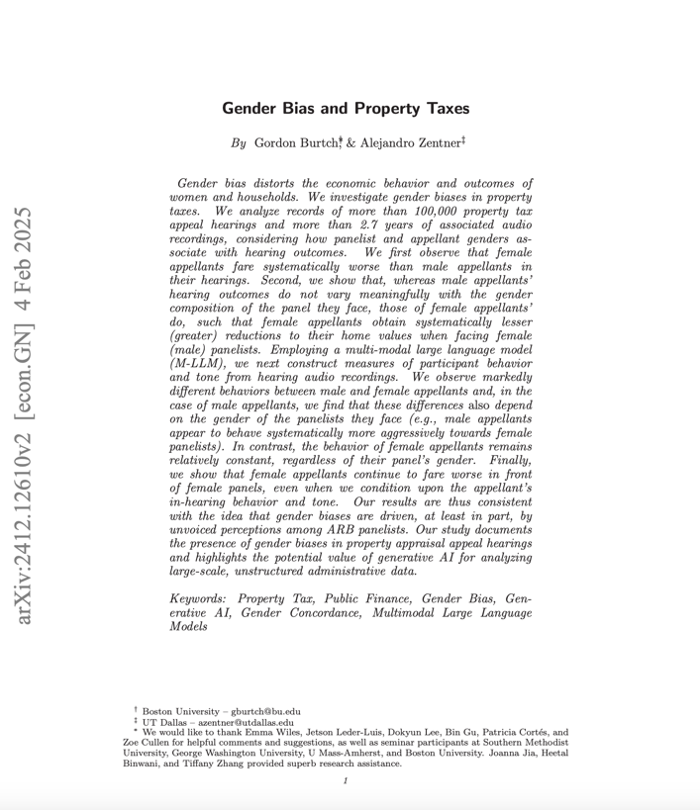
Some Research

Slide 5
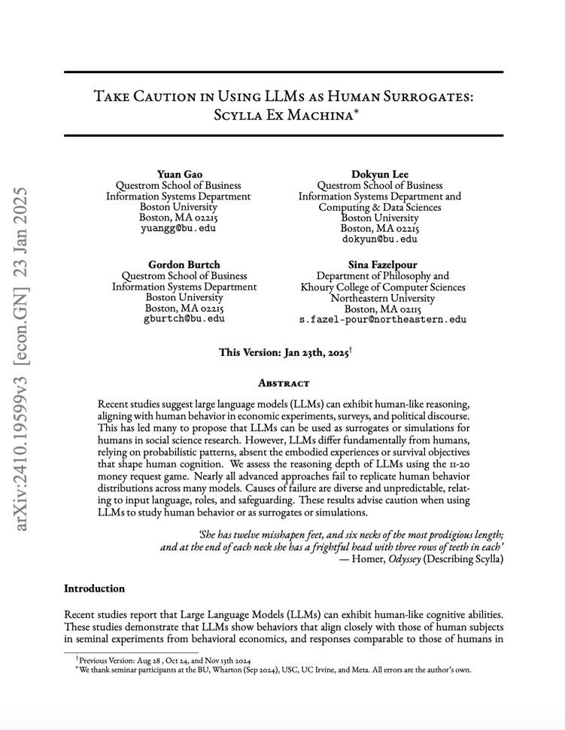
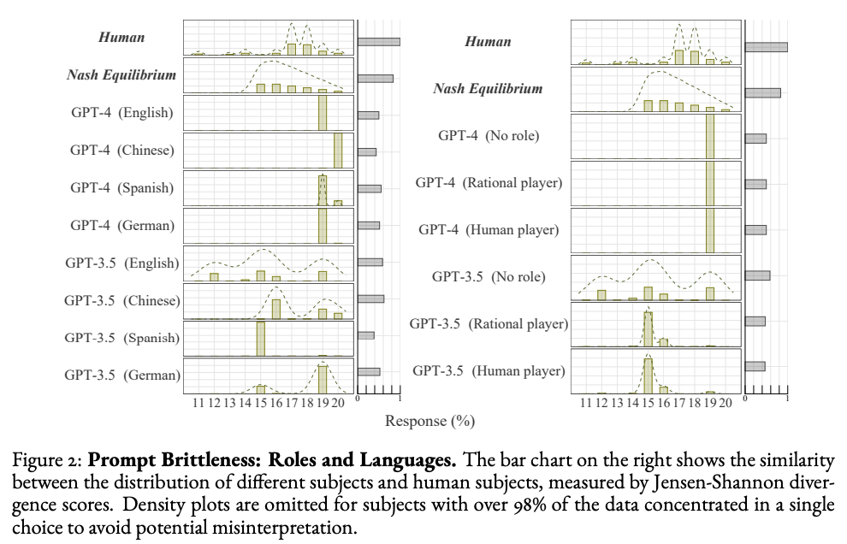
Some Research

Slide 6
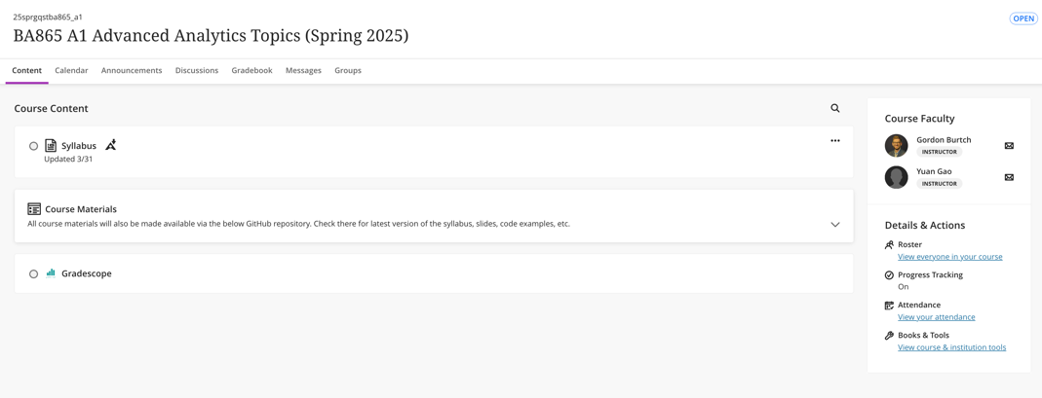

Course Materials
COURSE WEBSITE
The course website is on Blackboard – I assume you have looked at it by this point (if you aren’t enrolled in the site, let me know)
You will submit all assignments and receive relevant course announcements via that site.
I will post lecture materials and in-class exercises / examples via the GitHub Repository linked on Blackboard.
GOOGLE COLAB
All homework and exercises in this course are to be implemented in Python. You should work in Google Colab because we (the TA and I) will not be able to provide technical support if you run into issues with your local intance. You also need to submit .ipynb files that run in a clean Colab instance (we won’t debug your code)

Slide 7
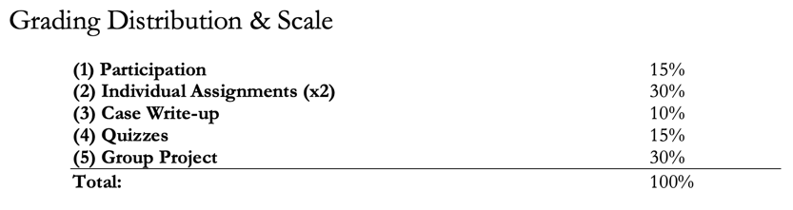
Grading and Evaluation
PARTICIPATION / ATTENDANCE
Regular attendance and participation will be worth 15% of your final grade.
INDIVIDUAL ASSIGNMENTS
Two (2) assignments worth 30% of your final grade together (15% each)
Due by 11:59pm on the date indicated in the course schedule – submit your Jupyter (Colab) Notebook file via Blackboard (submit the actual file with code, not a link to your notebook).
Late submissions will result in grade deductions, per the syllabus.
CASE WRITE-UP
We will discuss the AI Wars case in class, and your submitted individual responses to case questions will be worth 10% of your final grade.
QUIZZES
We will have 4-6 in-class, timed, paper and pencil quizzes. collectively worth 15% of your final grade).
GROUP PROJECT
The final project (worth 30% of your final grade) is a hands-on implementation driven by you.
You will work in groups of at least three but no more than four students to implement a neural network-based predictive model that addresses a practical problem of interest to you! You must source a dataset (not from Kaggle), motivate the prediction problem (explain why it’s practically relevant), and then implement your model. Your goal is to make a useful project for you!
Deliverables include a project proposal, a mandatory mid-point check-in meeting with me to ensure you are on track, submission of final code and slides, a Medium-style blog post (40%), and a final presentation (50%) made during the last week of class.

Slide 8
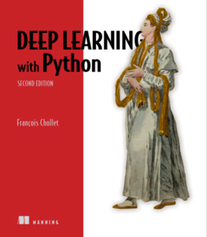
Course Textbook
Chollet, François. (2021). Deep Learning with Python (2nd Edition). Manning Publications Co. ISBN-13: 978-1617296864. https://www.manning.com/books/deep-learning-with-python- second-edition

Slide 9

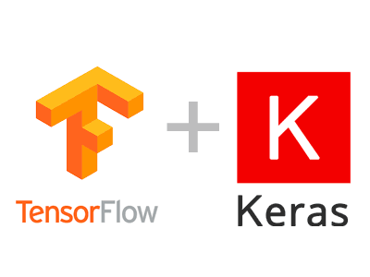


Required Software
SOFTWARE CONFIGURATION
You can access Google Colab at https://colab.research.google.com. You probably want to use your BU Google account credentials.
You may need to resort to local Python or some other virtual machine setup when it comes to your final project, depending on the scale of your data / problem. Note that the TA and I cannot provide technical support for your personal implementation.

Slide 10
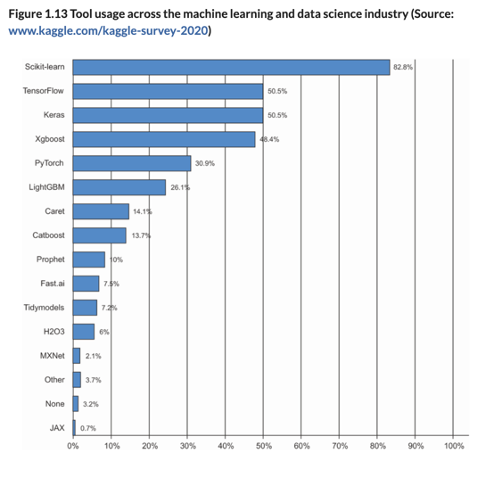
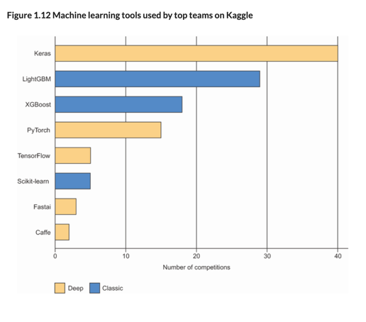
Why Keras?

Slide 11
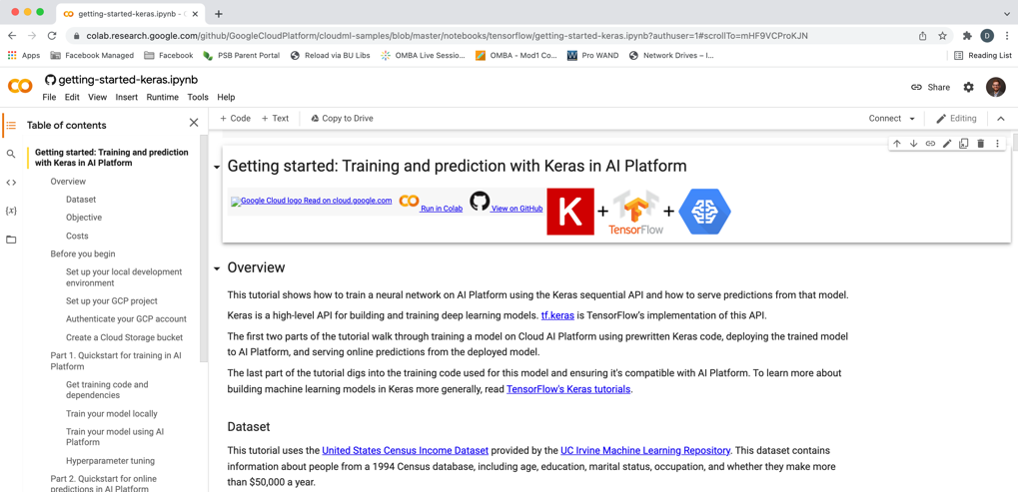
Google Colab

Slide 12
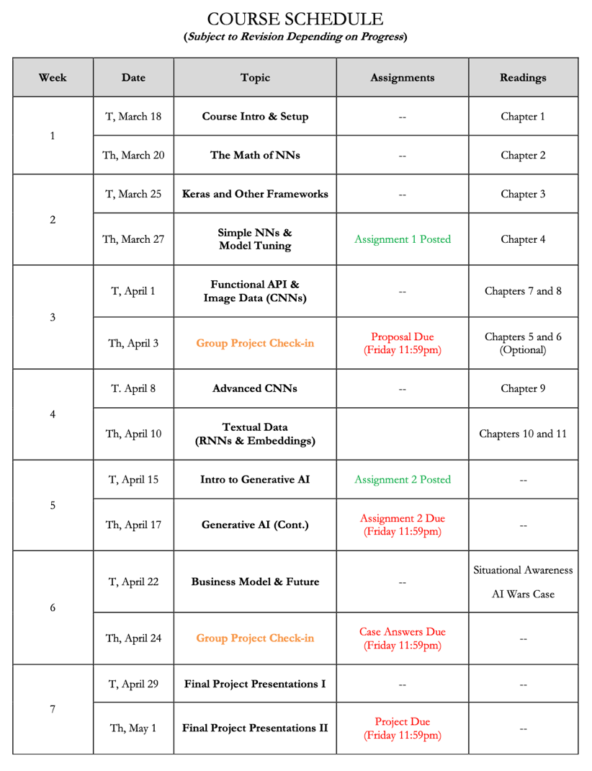
Course Timeline
AGENDA
We will start with the basic math concepts.
We will then get into neural networks for simple prediction problems.
Finally, we will explore more complex use cases: computer vision, audio and text.
NOTE TIMING OF DELIVERABLES
First homework on basic prediction.
Second homework on implementing RAG based on document embeddings with a small pre-trained LLM.
I will announce sign-ups for the first project proposal check-in meeting on 4/3.

Slide 13

Course
LECTURES
We will meet twice weekly for ~2.5 hours each session. I will incorporate a 20-minute break in the middle of each session. The first half of each session will focus on lecture / concepts / explanation.
HANDS-ON EXAMPLES
The second half of each session will be focused on walking through hands-on examples and demonstrations in Python notebooks. I will provide Jupyter Notebooks and data-sets (typically via GitHub), which we will walk through together.
You are encouraged to ask questions as we progress.
Note that the quizzes, individual assignment, and exam will be based on the in-class material. I will not test you on things that were not discussed in class.

Slide 14
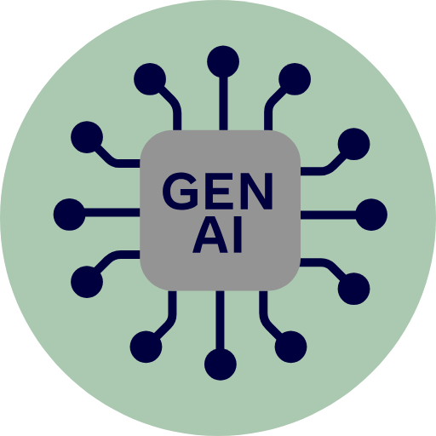
Policy
YOU CAN USE IT TO HELP YOU LEARN AND PERFORM BASIC TASKS
I expect you to use these tools. However, the way you use them matters. Some valid use cases include …
Implementing data munging tasks that you already understand based on past coursework, e.g., pre-processing text.
Automatic generation of code comments or documentation.
YOU SHOULD NOT GENERATE SOLUTIONS FROM SCRATCH
If you use these tools as a shortcut to avoid understanding the course material, you will not do well in this class. If we encounter functions and practices that were not taught in the course (e.g., PyTorch code), you will be asked to explain your code to us orally. If you are unable to explain what the code is doing, points will be deducted from your grade.

Slide 15
Any Questions?

Slide 16
What is ‘Deep’ (vs. Shallow) Learning?
https://chat.openai.com/chat
Notes:
Let’s ask ChatGPT!

Slide 17
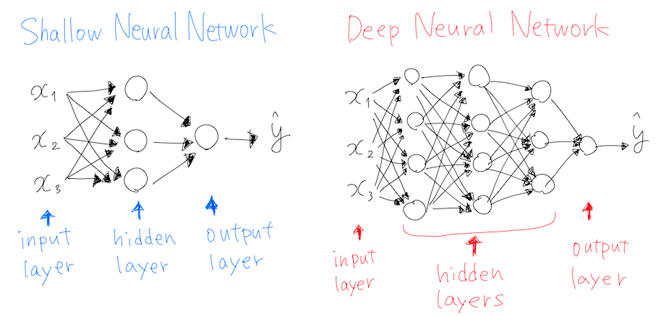
What is ‘Deep’ Learning?
Notes:
Most other ML approaches are shallow (they map inputs to outputs in a single layer / transformation, or few layers). Deep here refers to the fact that there is a layered approach to transformation. 4 or more layers, generally, by which transformations feed into other transformations, enabling flexible representation of mappings.

Slide 18
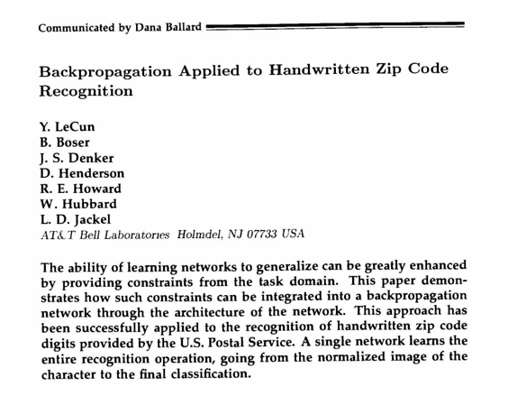
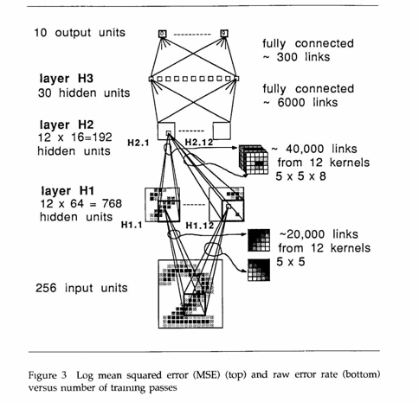
Where Deep Learning Started

Slide 19
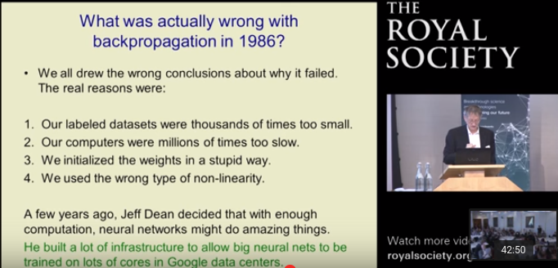
Then It Shuffled Along for Decades…
Now…
Notes:
Vanishing gradient problem,

Slide 20
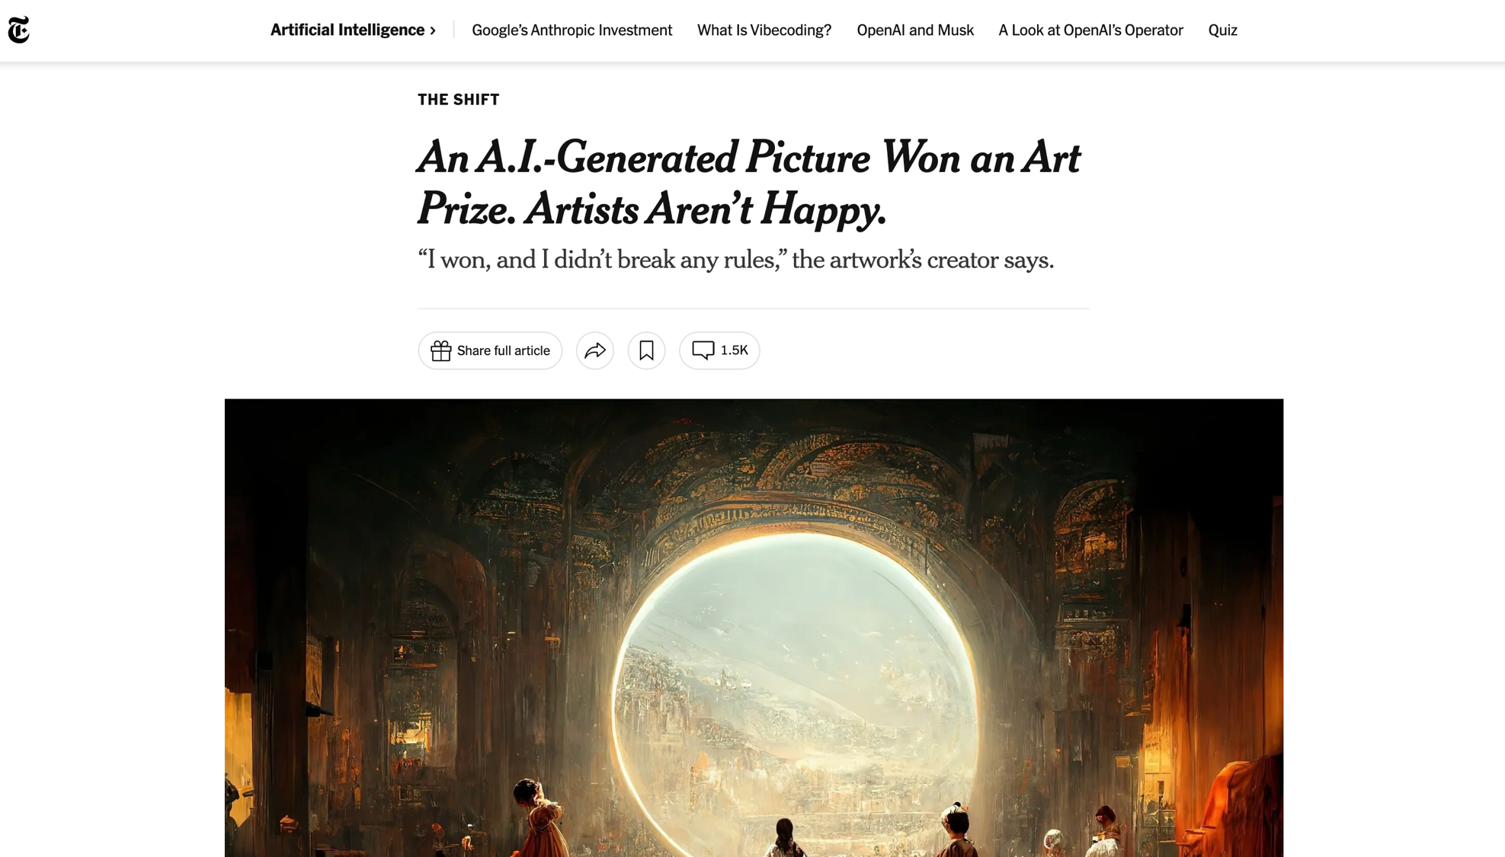

Slide 21
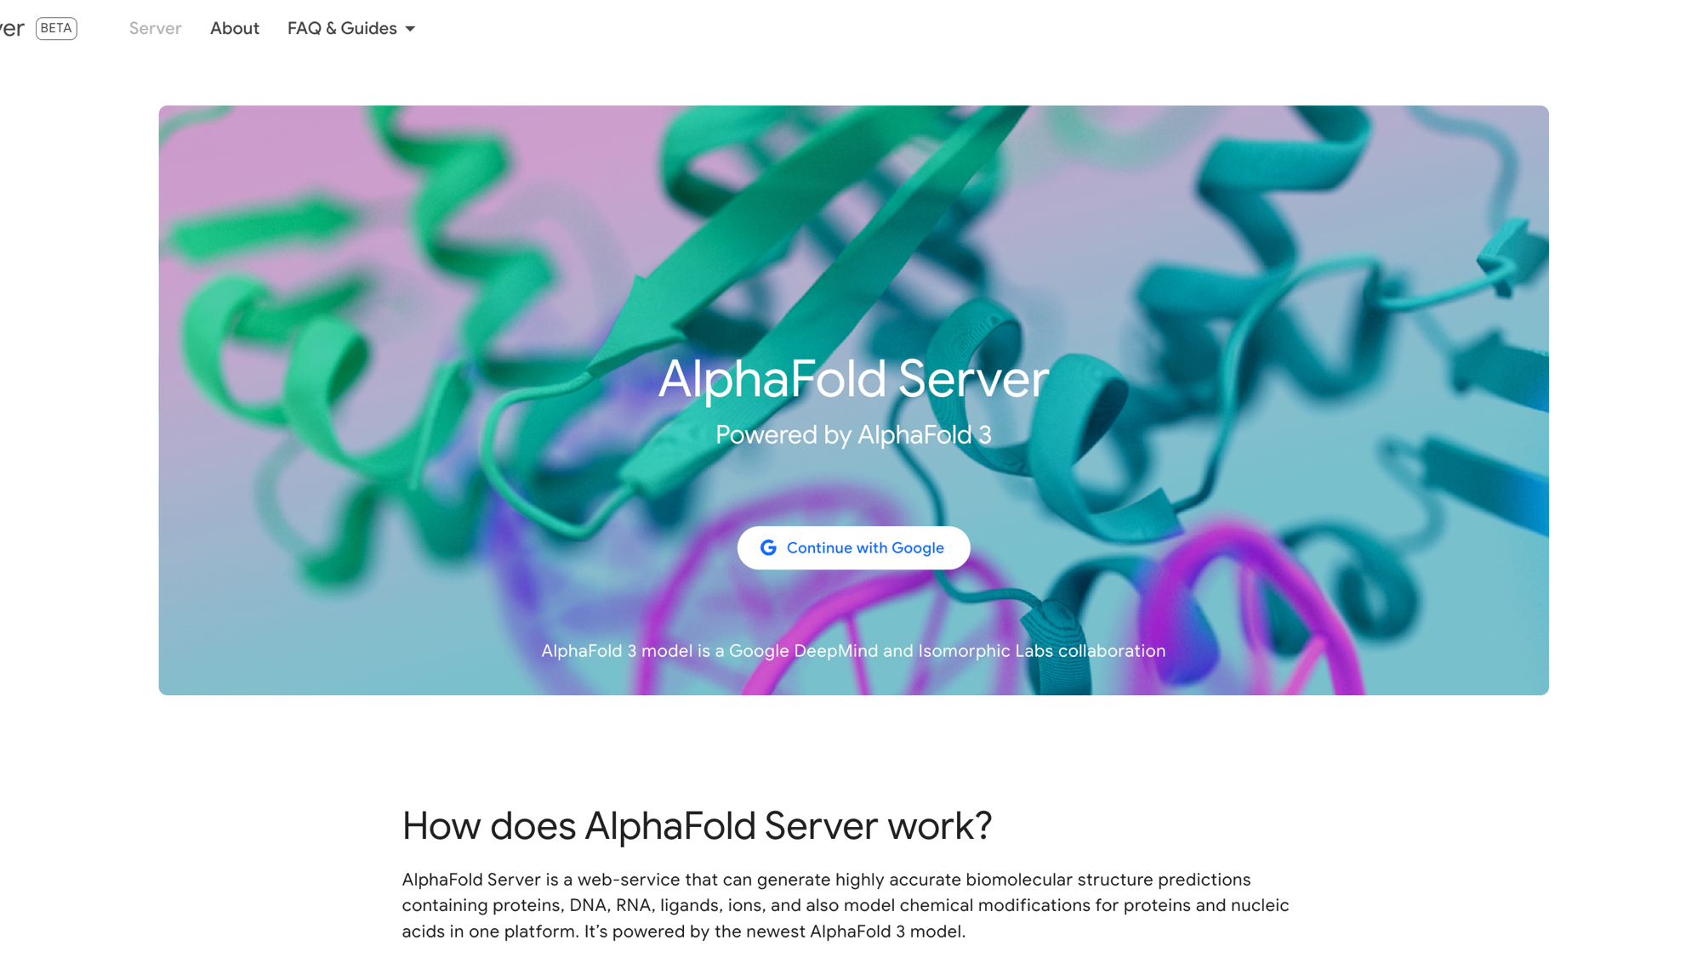

Slide 22
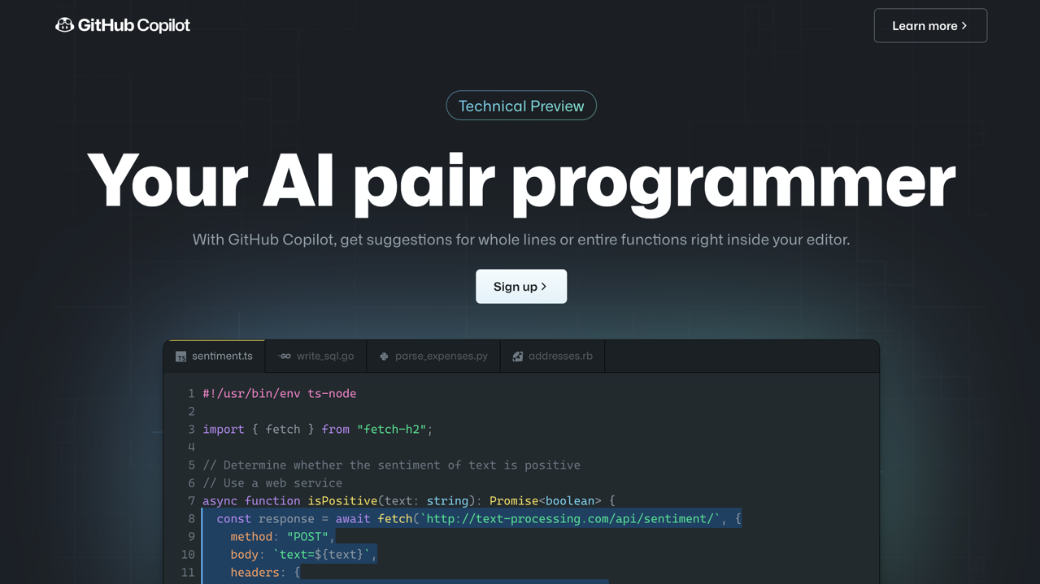

Slide 23
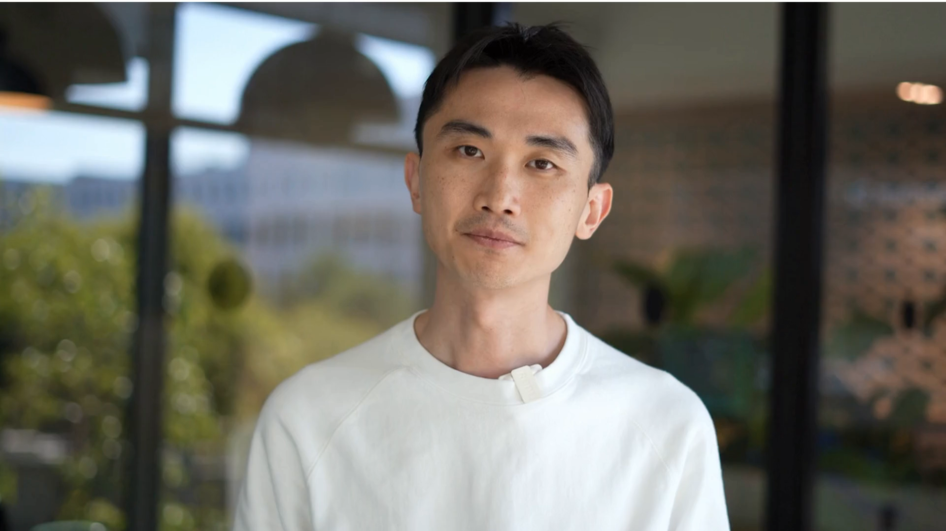

Slide 24
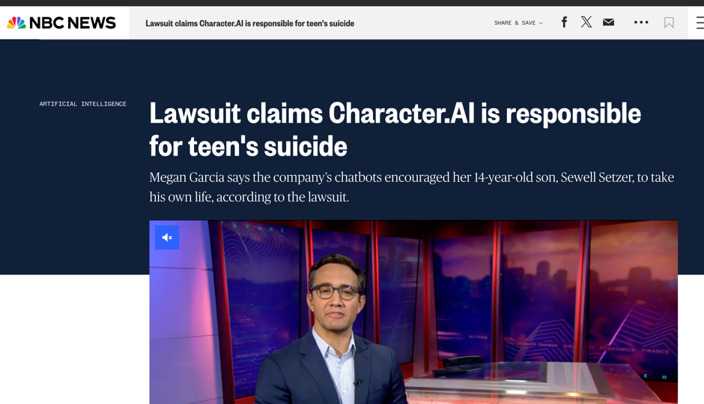

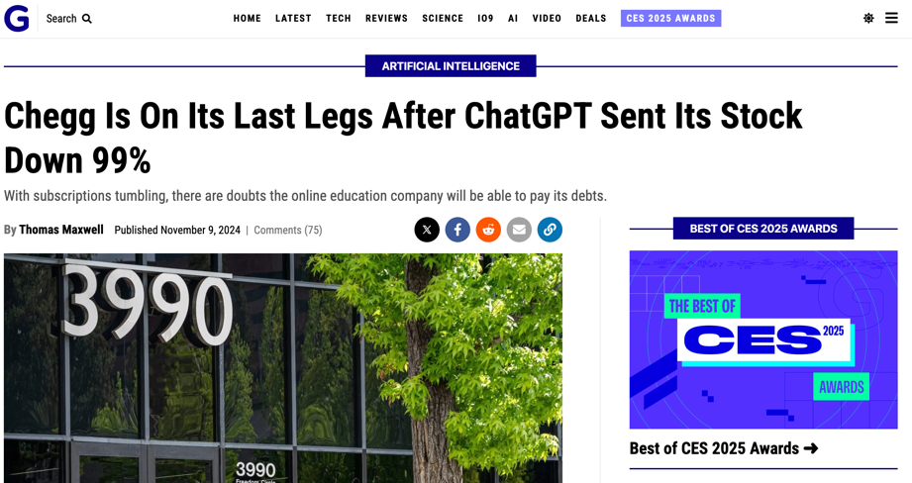
These Technologies Bring New Problems

Slide 25
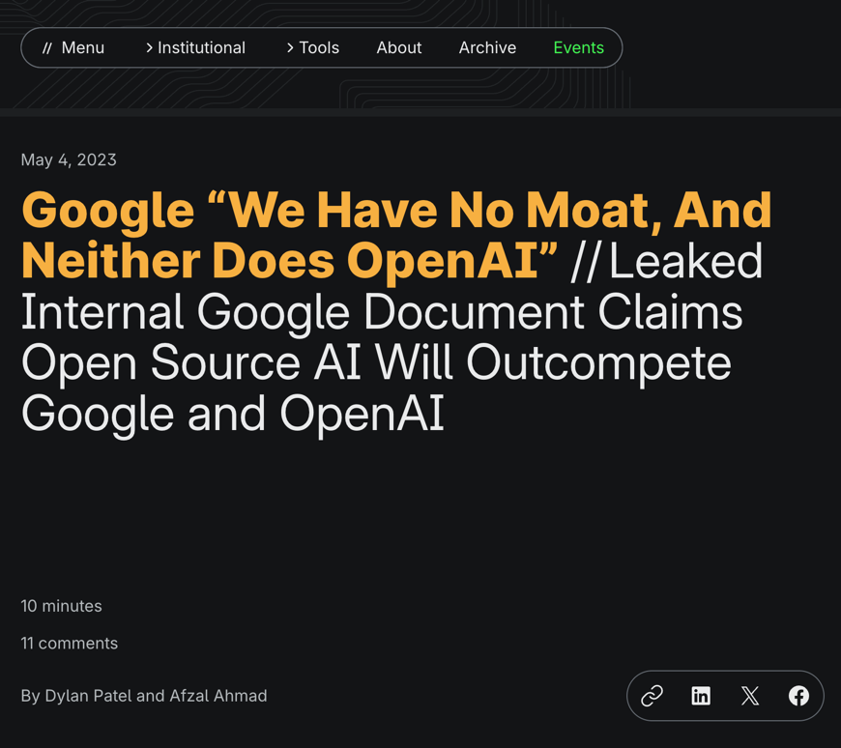
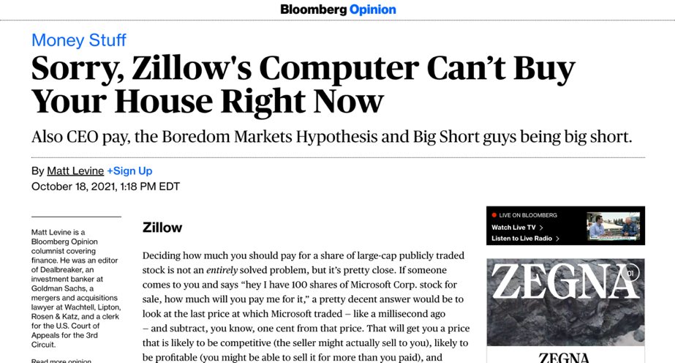
Business Process / Model Still Matters

Slide 26
How It Works, Conceptually

Slide 27
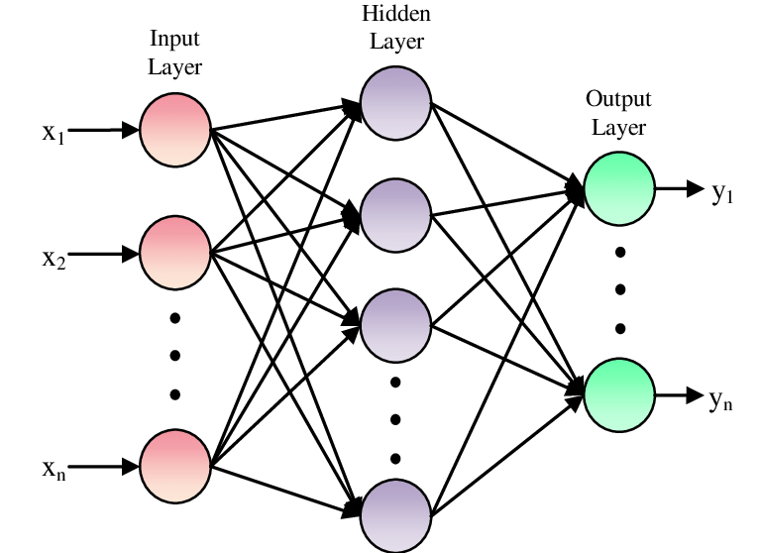
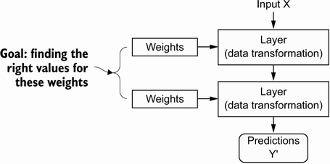
Model Parameters

Slide 28
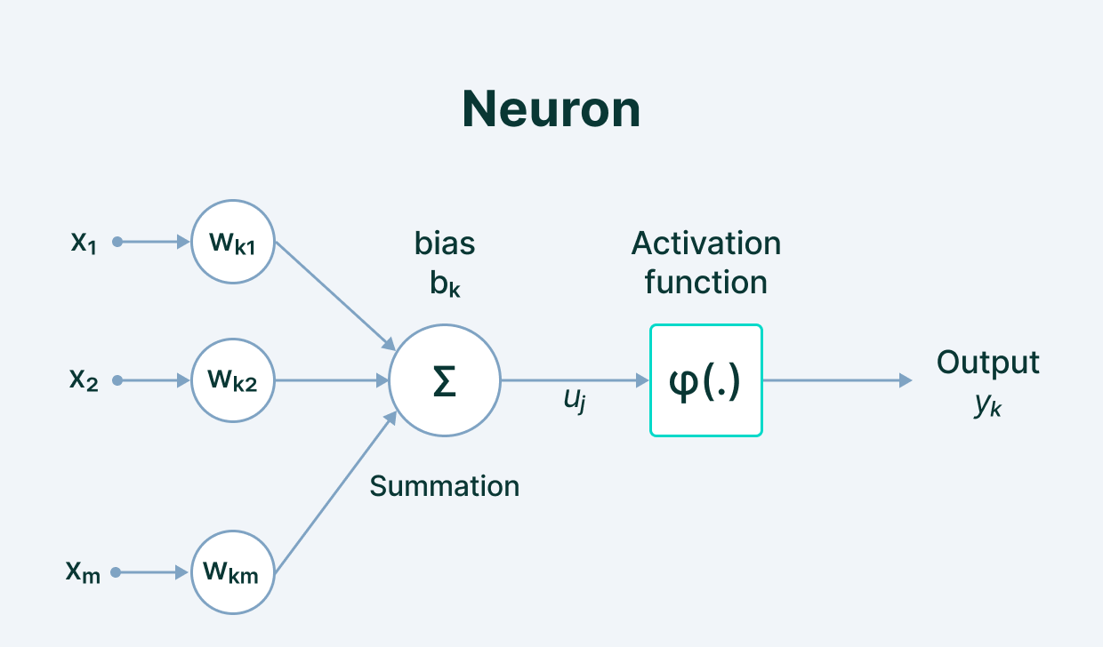
Model Parameters
Notes:
We define the network structure (layers / nodes / edges) and the activate functions (within each node). Our data, X and Y (inputs and labels) are given. Our goal is then to “learn” the remaining parameters, i.e., the w’s and b’s.

Slide 29
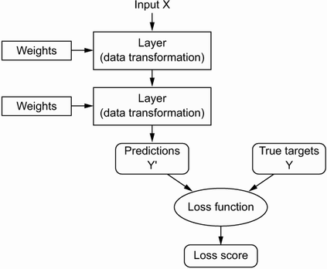
Loss Function (Error)
Notes:
How do we learn the parameters? We need a way to quantify how well we are doing. This is what the loss function is for; it informs our optimization about how ”optimal” our current set of parameter values is.

Slide 30
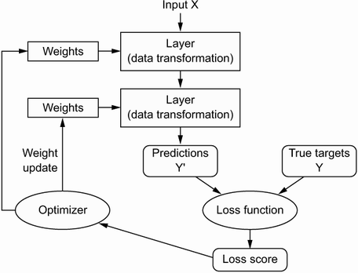
Optimization
Notes:
How do we implement the learning (optimization)? Gradient descent. We identify where we are on the loss curve, figure out a first derivative along all available dimensions (i.e., along all parameters), and proceed where the gradient is most negative (i.e., where the loss function progresses most rapidly toward zero. For this to work, we need to be able to figure out the gradient along each dimension (for each parameter) in a computationally efficient way (remember, some of the biggest models have thousands or millions of parameters!).

Slide 31
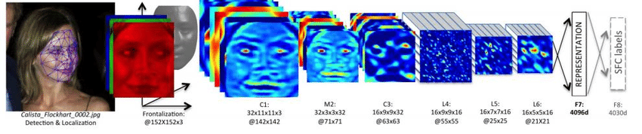
When to Learn Deeply (vs. Not)
COMPLEX RELATIONSHIPS
Complex, non-linear, interactive relationships and mappings; common use cases involve unstructured (high dimensional) data. Deep learning techniques remove the need for feature engineering, a daunting task.

Slide 32
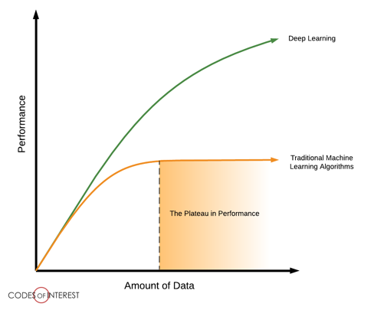
When to Learn Deeply (vs. Not)
LOTS OF DATA ON HAND
To be able to learn those complex mappings, typically requires many, many, many training examples.

Slide 33
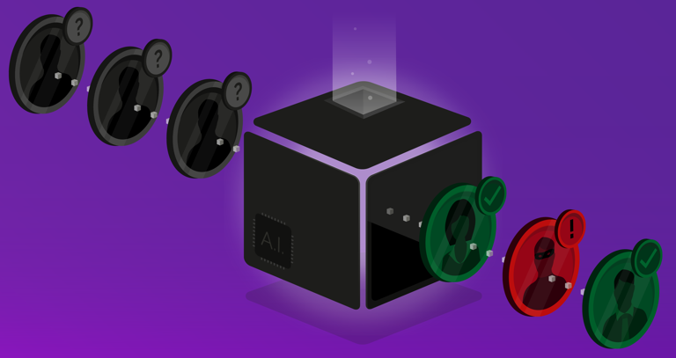
When to Learn Deeply (vs. Not)
LITTLE NEED FOR UNDERSTANDING
Although there have been advancements in explainable and interpretable AI, deep nets are notoriously “black box” algorithms.

Slide 34
Why Did Deep Learning Take Off?

Slide 35
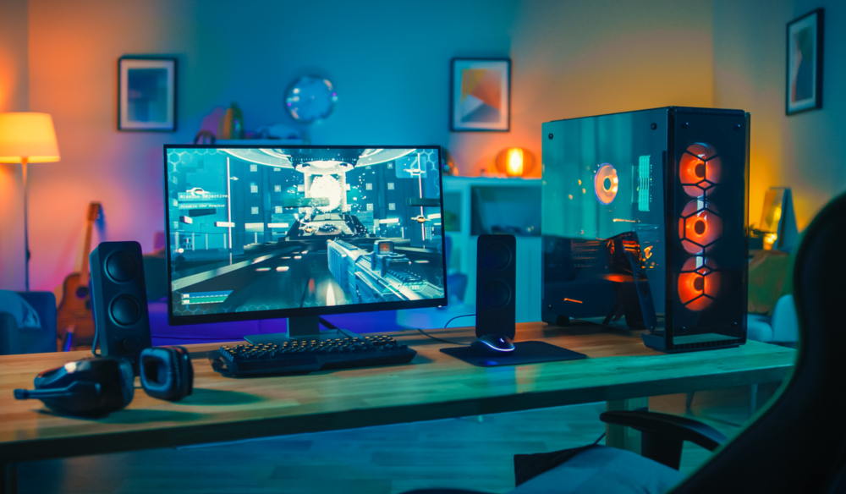
Video Games
Notes:
GPUs were developed to handle parallel processing capabilities needed for high end video game graphics. Turns out those same designs were useful for training a neural net (parallel computation, through vectorization of code). Basically, training a deep net involves performing a shitload of matrix multiplications. It’s better if we can do those calculations in parallel rather than sequentially. GPUs (and now TPUs) enable a ton of parallelization, speeding up the calculations.

Slide 36
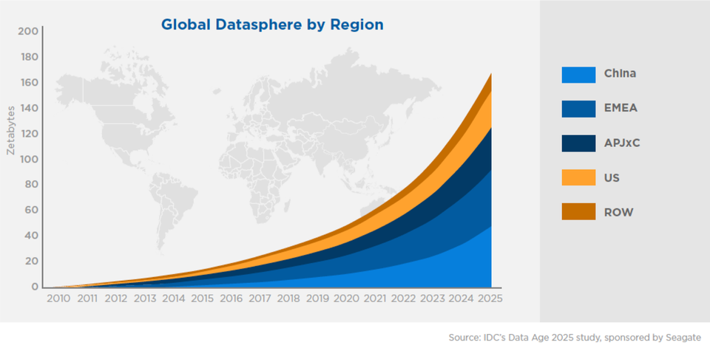
Data

Slide 37
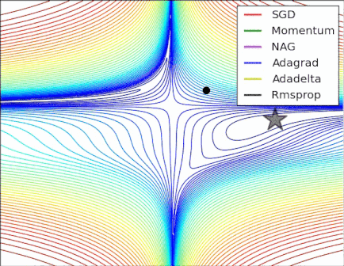
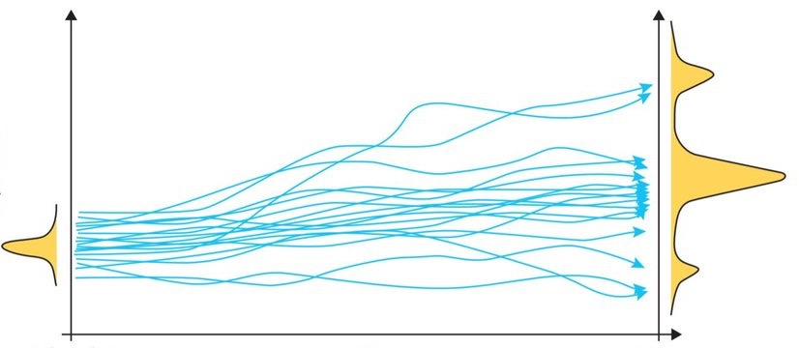
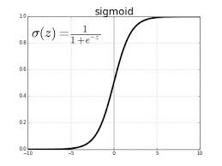
Algorithmic Improvements

Slide 38
Questions?

Slide 39

Quick Walk-Through of Google Colab

